Slide 1
Nominating Caucus Orientation

Slide 2
Caucus Attendees
Delegate – only the Delegate can vote (generally immediate Past President of Chapter)
Alternate (generally President Elect of Chapter)

Slide 3
Nominating Committee Members
Nominating Committee members including: one delegate, one alternate and one reserve alternate who are selected by the regional members and alternates from each chapter and represent the Region at Summer and Winter Nominating Committee meetings

Slide 4
Purpose of Nominating
Committee Caucus
Primary responsibility – To represent your Chapter, Region, and Society members
Purpose -To nominate candidates to replace elected officers and members of Society who are completing terms.
Nominate for Regional positions for terms about to expire. (Director and Regional Chair, Regional Vice Chairs, Region Members Council Representative)
Nominate candidates for Society, Regional and Chapter Awards
Recommendation of nominees for Fellows, DSA, etc

Slide 5
Caucus
PLEASE COME PREPARED TO FULFILL YOUR DUTIES

Slide 6
Nominating Committee
Confidentiality
Meetings of Nominating Committee are held in closed session
No member or alternate shall divulge any information on the work of the committee EVER and FOREVER!
What is said in the Executive Session, stays in the Executive Session

Slide 7
Caucus
Purpose: To discuss candidates for offices, committees, honors and awards without restrictions.
Orientation during Planning Meeting for the Caucus will be held as an Executive Session for purpose of instruction by the Regional Nominating Committee and the beginning of thought process for Caucus held at CRC.
Caucus is attended only by chapter delegates and alternates and by regional Nominating Committee member, alternate and reserve alternate

Slide 8
Nominating Committee Meetings
Two official meetings are scheduled
List your meeting times
  IF BUSINESS IS NOT COMPLETED IN FRIDAY SESSION

Slide 9
Attendance - Nominating
Committee Caucus
If a Delegate member cannot attend or is late arriving at the 1st CRC Caucus meeting, the Alternate member will replace the absent member as the voting participant.
Replaced member becomes an alternate if he/she comes late or can only attends the second session. He will not assume Delegate roll and will not vote.

Slide 10
Slate of Nominees
“The office shall seek the person, rather than the person seek the office”
More than one name can be submitted for each position, but must be ranked in order of priority in the Caucus for any Society Level office including the DRC position.

Slide 11
Society Board of Directors
Officers
  President (already elected in prior year)
  President-Elect (highest elected office)
  Treasurer
  Vice Presidents (4)
  Secretary (non-voting member, appointed)
Directors
  Director and Regional Chair (DRC) for each region (14)
  Directors-at-Large (DAL) (9)
Presently 30 voting members on BOD

Slide 12
ACRONYMS
ARC Assistant Regional Chair
CRC Chapters Regional Conference
DAL Director at Large
DRC Director & Regional Chair
RAL Region at Large
RMCR Region Members Council Representative
RVC Regional Vice Chairs

Slide 13

Society Structure
ASHRAE Foundation
ASHRAE
MEMBERSHIP
Nominating Committee
Advocacy Committee
ASHRAE Associate
Society Alliance
Executive Committee
BOARD OF
DIRECTORS
Building Energy Quotient
Committee
Finance Committee
President-Elect
Advisory Committee
Planning Committee
Society Rules Committee
Members Council
Technology Council
Publishing &
Education Council
Chapter Technology Transfer
Environmental Health
Certification
Chapters Regional
Electronic Communications
Conferences & Expositions
Refrigeration
Handbook
Grassroots Government
Activities (7/1/13)
Research Administration
Historical
Honors and Awards
Standards
Professional Development
Membership Promotion
Technical Activities
Publications
Research Promotion
Student Activities
Young Engineers in ASHRAE

Slide 14
2014-2015 Officer and
Director Positions to be Filled
President-Elect
Treasurer
Vice Presidents (4) – 2 eligible for re-election
DALs (3)

Slide 15
Eligibility - BOD
Only Members, Life Members, and Fellows shall be eligible for election as President, President-Elect, Treasurer, or Vice President
Treasurer and Vice Presidents eligible for re-election to same office for 1 additional consecutive year

Slide 16
Recommendation for
Society Committees
Recommendations are made to the Society President-elect. These are not elected offices, they are appointed by the president.
Chapter members wishing to serve on a committee can be recommended through the CRC by submitting names to the Delegate Member at the Caucus (may self appoint)

Slide 17
Nominations during Caucus
Current committee members of the Caucus eligible for candidacy are asked to step out of the session during discussion of their candidacy. Nominating member & alternate are eligible to serve for six years total.
If Nominating Committee member or alternate are proposed for a position, they will also be asked to leave the session during discussion and the member remaining will Chair the session until discussion is complete.

Slide 18
Candidates for Regional Offices
ARC Term is 1 year and an appointment. May also be the RMCR.
Submit three names for each Regional Vice Chair positions due for replacement to the DRC for appointment. Names to be ranked in order of preference
This year for ???????

Slide 19
Documentation
All candidates must be contacted to determine willingness to serve if elected. Candidates should update their bios.
An ASHRAE updated biography must accompany each candidate and can be obtained by you from Member Services at Headquarters 404-636-8400 or www.ashrae.org (updates can be done online).
Download Bio from ASHRAE website, print a copy and send a copy to the Nominating Committee Chair for distribution to the other Delegates and Alternates for their review before the CRC. This will greatly speed the Caucus. There is no need to distribute Bios for Honors and Awards.
Please provide e-mail address to the Nominating Committee Chair for distribution before leaving the Planning Meeting.

Slide 20
Society Honors and Awards
Must be accompanied by an ASHRAE Bio AND at least one letters of recommendation from a nominator, member and/or interested party. Points sheet must accompany Chapter Service Award, Regional Award of Merit, Distinguished Service and Exceptional Service Awards.
A letter from the Chapter President is recommended.
Photo is necessary for some awards.

Slide 21
Recommendation for
Regional Awards
Regional Award of Merit (10 points required-see point sheet Manual of Chapter Operations Appendix N3, – no limit) awarded by the DRC at CRC
Chapter Service Award (15 points required-see point sheet Manual of Chapter Operations Appendix N4 –) EVERY CHAPTER SHOULD PROVIDE 2 NAMES OF CHAPTER MEMBERS TO HONOR each year. Past presidents deserve it. Awarded by the DRC at CRC (no max limit)

Slide 22
Submittals to Region DRC
All nominations for Regional Award of Merit must include a letter of recommendation from the chapter and a current biographical record form.
  Also include desired wording for certificate. i.e.: “For Outstanding Service to Region # as Director to Regions Council 20_-__”
All nominations for Chapter Award of Merit must include a letter of recommendation from the chapter and a current biographical record form.
  Also include desired wording for certificate. i.e.: For His/Her Service to the Atlanta Chapter of ASHRAE as ____________.”

Slide 23
Society Awards
Honorary Member (eminent professional distinction – 3 per year max. Winter Mtg.)
Fellow (grade awarded for unusual distinction- See Manual of Chapter Operations Appendix N2 for criteria-no limit awarded at Winter Mtg.)
F. Paul Anderson Award (notable achievement or outstanding work or service – 1 per year max. awarded at Winter Mtg.)
ASHRAE-ALCO Award (outstanding public service – 1 per year max. awarded at Winter Mtg.)

Slide 24
Society Awards (cont.)
Distinguished Service Award (Society work – 15 points required- see point sheet Chapter Manual of Operation Appendix N1-no limit, awarded at Annual Mtg)
Exceptional Service Award (continued distinguished service-45 points required- see point sheet Chapter Manual of Operation Appendix N1 -20 max., awarded at Annual Mtg)
Andrew T. Boggs Service Award (exemplary distinguished service – 1/yr. max, awarded at Annual Mtg )
Distinguished 50 year member (50 yr. member who has been a Society President, Fellow, DSA recipient, or otherwise performed outstanding service for the Society- no limit, awarded at Annual Mtg.)

Slide 25
Society Awards (cont.)
Louise and Bill Holladay Distinguished Fellow Award (continuing preeminence in engineering or research work-1/yr., awarded at Annual Mtg)
E.K. Campbell Award of Merit (Honors outstanding service and achievement in teaching-1/yr, awarded at Winter Mtg)
ASHRAE Hall of Fame (milestone contribution to growth of ASHRAE-related technology by deceased members –see website under Honors & Awards for nomination form- 2/yr max, Winter Mtg) George Hightower has been nominated, why hasn’t Benny Bootle been nominated?

Slide 26
Society Committees
Delegates should poll the members they think could contribute to Society as committee members, this is the easiest way for the Society President-elect to fill the positions available. Ask at your chapter meeting.
  Accreditation Activities
  Admissions & Advancements
  ASHRAE Planning
  ASHRAE Programs (not chapter programs)
  Chapters Regional
  Charter & Bylaws

Slide 27
More Society Committees
Course Development
Chapter Technology Transfer
Environmental Health
Executive
Finance
Handbook
Historical
Honors & Awards
International
Journal/Insights
Membership Promotion
Nominating
President Elect Advisory
Refrigeration
Research Promotion
Special Publications
Student Activities

Slide 28
More Society Committees
Standards Committees
  Standard Projects & Guidelines Projects
  Code Interaction
Technical Activities
  See website for listings
These committees can be joined by contacting the current chair of the committee and express your interest.

Slide 29
Submittals to Society
All nominations for Society honors and awards must include a letter of recommendation from the chapter and a current biographical record form.
Nominations for Distinguished Service and Exceptional Service awards must include a completed tally points sheet.
Nominations for Hall of Fame must include an official nomination form. (deceased member only)
Society Honors and Awards committee will not consider incomplete submittals.
See Honors and Awards on the ASHRAE website for due dates for each award.

Slide 30
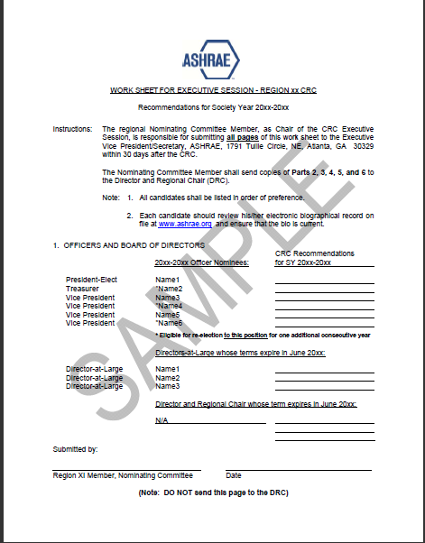
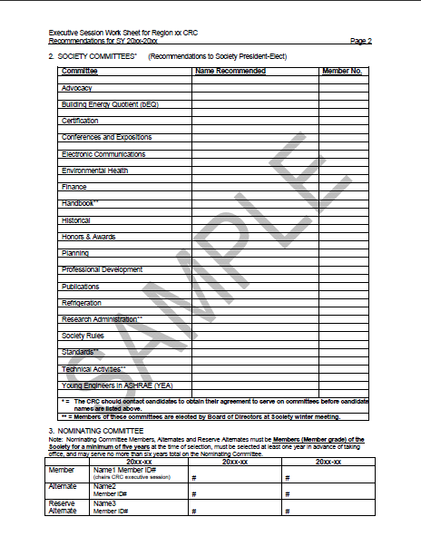
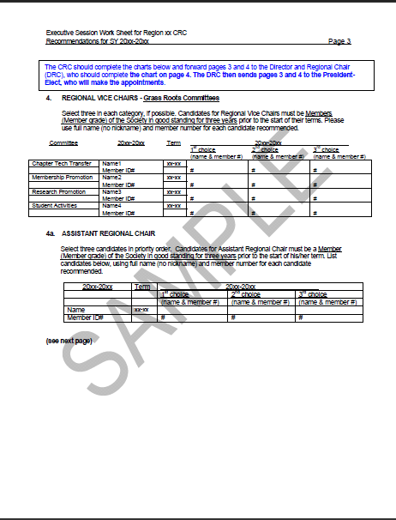
Sample Worksheet – MCO
Appendix X

Slide 31
Succession Planning
RVC – Chapter past Presidents
ARC/RMCR-Past RVCs
DRC – Past ARC/RMCR

Slide 32
Wrap-Up
Call me with questions
It is possible to complete the work in the first session. If so, the second session will be suspended – AND YOU CAN SLEEP IN AN EXTRA HOUR!

Slide 33
Your Turn
Questions and Answers

